Slide 1
Transparent Assignments
Promote Equitable Opportunities for Student Success
Mary-Ann Winkelmes, Ph.D.
Coordinator, Instructional Development & Research, UNLV
Senior Fellow, Association of American Colleges & Universities
Nevada Humanities Board of Directors member
Founder and Principal Investigator,
Notes:
Hello, I’m MAW, founder and principal investigator of the Tspcy in Learning and Teaching in Higher Education Project, know by its acronym, TILT Higher Ed.
Recently, our research identified transparent assgt design as a simple, replicable teaching intervention that significantly benefits students’ learning – with even larger benefits for underserved college students students (1st gen studts – first in their family to attend college, ethnclly underrep studts, and students of low-SES).
So our findings have identified a teaching intervention that provides more equitable opportunities for all college students to succeed. This is especially important now that underserved students (1st gen studts, ethnclly underrep studts, and students of low-SES) comprise the new incoming majority of college students in the United States.
I want to acknowledge the members of our research team who contributed to those findings, along with our partner schools.

Slide 2
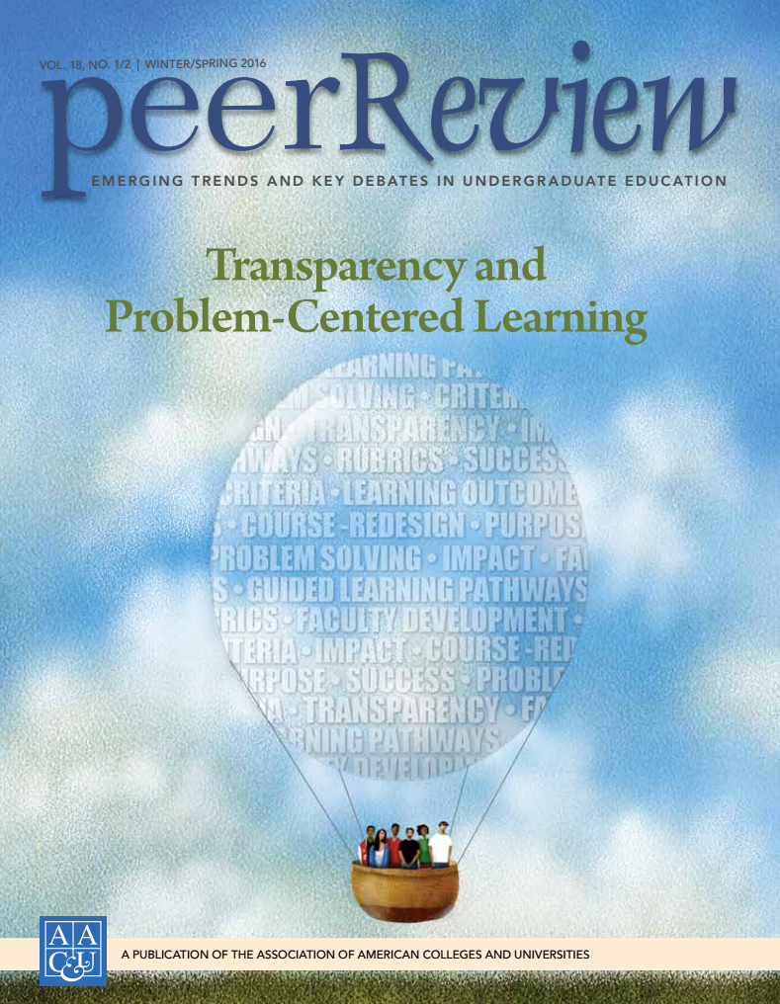
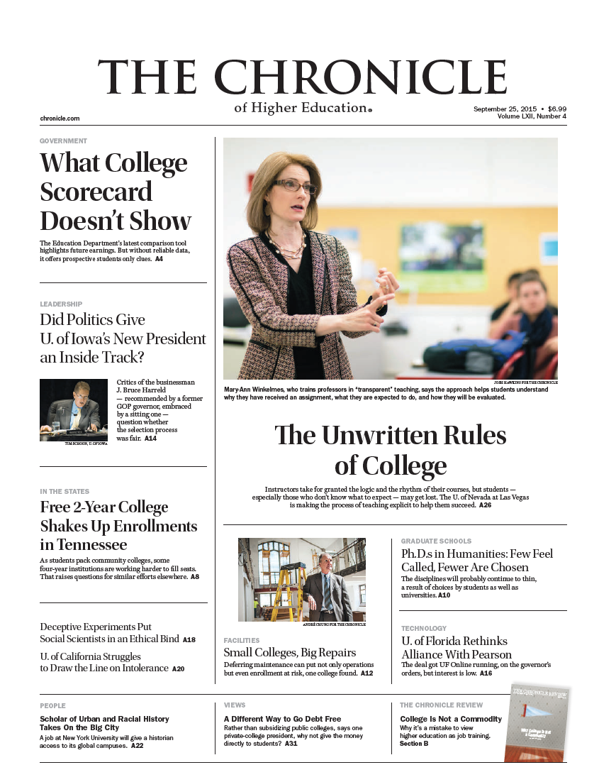

Slide 3
Overview
PURPOSE:
  Understand how transparently designed assignments can offer equitable opportunities for all college students to succeed; and consider applications
TASKS:
  Review: summary of research findings
  Apply: in your own courses
CRITERIA:
You’ll leave with
  Understanding of our research
  Strategies (draft) for applying transparency in assignments

Slide 4


Partnership with
  Grant from: TG
Co-PIs: Tia Brown McNair, Ashley Finley, AAC&U
Schools:
  Community College of Philadelphia
  Queensborough Community College, Bayside, NY
  St Edward's Univ. Austin, TX
  Univ. of Houston – Downtown, TX
  California State University, LA
  Winston-Salem State University, NC
  Heritage University, Toppenish, WA
Publication: Peer Review (Spring 2016)
Notes:
Like to ack the Partnership with the AAC&U that made this recent research possible, along with grant funding from TG Philanthropy. Tia M and Ashley F from the Association of American Colleges and Universities were my co-investigators. 7 MSIs participated.

Slide 5
Research Team:
Transparency Project team members, UNLV
  Matthew Bernacki, Ph.D. (consultant)
  Jeffrey Butler, Ph.D. (research, analysis)
  David Copeland (consultant)
  Jennifer Golanics, J.D., M. Ed. (analysis)
  Sherry Marks (budget)
  MaryKay Orgill (consultant)
  Kati Harriss Weavil M.Ed. Candidate (analysis)
  Michelle Zochowski, M. Ed. candidate (analysis)
Notes:
Research team members

Slide 6
CONTEXT

Slide 7
Equity of Access
Equity of Experience
Underrep, First Gen, Low Income:
half as likely to complete in 4 years
High-achievement in HS can frustrate college success
Well-prepared novices don’t think like experts
Gatekeepers stunt research
Notes:
Black, Hispanic, Native American and Pacific Islander students are just about half as likely to complete a four-year college degree as their White and Asian classmates (U.S. Department of Education January 2014). Completion rates for low-income students lag far behind those of students whose family incomes are above the bottom quartile (Tough 2014). And first generation college students are 51% less likely to graduate in four years than students whose parents completed college (Ishtani 2006). PREACHING TO CHOIR: HIPs

Slide 8
Your Challenges | Your Strategies
Lack of preparation / understanding critical thinking skills apply prior expectations unclear about expectations don’t use/know resources | smaller staggered tasks in sequence with regular due dates students submit workplan before starting offer multiple examples: past work
Motivation feel overwhelmed fear of failure anxiety don’t know how to proceed | critique examples of work in- class guided peer response practice drafts with feedback low-stakes chances to practice before the big work is due
Time management group project balance procrastination underestimate time needed overextended in commitments | required office hour meeting for feedback rubrics, timelines reminders, check-ins

Slide 9
What is Transparency?
Transparent teaching and learning methods explicitly focus on how and why students are learning course content in particular ways.
Notes:
This idea evolved out of series of seminars I offered beginning in the late 1990s. Seminars for Fac and Instructors focused on topics in teaching andlearning at the teaching centers of Harvard U, U of Chicago and U of Illinois.
Across those seminars, teachers explored an important question: If I had the time to change one thing about my teaching, what would be the one thing that would most benefit the population of students I have in my courses?
Instructors at the U of Chicago helped to develop the first version of the online Tspcy in Lrng and Teaching survey, to gather the information about students’ learning expces that teachers told us they needed to help them answer that critical question about how to adjust their teaching to benefit THEIR students.
We piloted that survey at U of Chicago and U of Illinois adjusted it, and then made it more widely available. We succeeded in providing confidential instructors reports that offered to teachers their students’ views about the 44 aspects of their learning experiences that teachers said would help them make informed choices about how to adjust their teaching.
The large scale of the grass-roots response by faculty all across the US and in several other countries meant that we accumulated more data than we ever expected! And enough to begin seeing patterns. For example, we noted that

Slide 10
How can Transparency help students?
Transparent teaching/learning methods benefit students who are unfamiliar with college success strategies by explicating learning/teaching processes.
  Greater benefits for underrepresented and first-generation students
Winkelmes, AAC&U’s Liberal Education 99, 2 (Spring 2013)
Notes:
Mary-ann

Slide 11
Transparency and Problem-centered Learning (p. 10)
AAC&U and Transparency Project collaboration
  7 MSIs, 1800 students, 35 faculty
    425 First generation students
    402 non-white students
    479 low-income students
    297 multiracial students
  2 x simple teaching intervention (2 assignments)
  Boosted students’ learning in 3 important ways (medium-large effect for underserved students):
    Academic confidence
    Sense of belonging
    Skills valued most by employers
Increased GPA, retention
Notes:
One-page research summary on page 10 of your handout contains the description I’m providing you here.

Slide 12
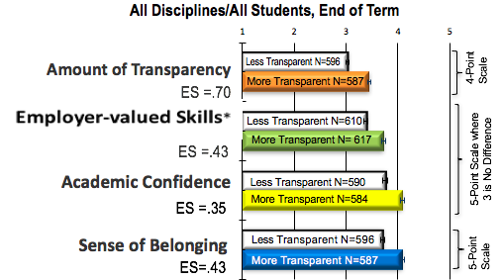

(p. 10)
*Hart Research Associates, Falling Short? College Learning and Career Success. Washington, DC: AAC&U, 2015.
KEY: N: number of students responding |__|: one standard error ES: effect size (Hedges’ G) Effect sizes of 0.25 standard deviations or larger are “substantively important” (US Dept of Education WWC, 2014, p. 23). Less Transparent: mean perceived transparency < 3.3/4 More Transparent: mean 3.3/4 * Hart Associates employer surveys, 2015, 2013.
KEY: N: number of students responding |_|: one standard error ES: effect size (Hedges’ G)** Less Transparent: mean perceived transparency <3.3/4 More Transparent: mean ≥3.3/4 * Hart Research Associates. Falling Short? Learning and Career Success. Washington, DC: AAC&U, 2015. ** Effect sizes of 0.25 standard deviations or larger are “substantively important.” (US Dept of Ed. What Works Clearinghouse Procedures and Standards Handbook version 3.0. Web. March, 2014, p. 23.)
© 2015 Mary-Ann Winkelmes
Notes:
For example, ethnically underrepresented (African-American) first-year college students who completed an exercise that aimed to increase their feelings of social belonging earned higher GPAs in the next three years, reduced the racial achievement gap, reduced their feelings of self-doubt, increased their confidence and were more likely to be in the top 25% of their college class (Walton Walton, Gregory M., and Geoffrey L. Cohen. 2011. “A Brief Social-Belonging Intervention Improves Academic and Health Outcomes of Minority Students.” Science 331 (6023): pp. 1447-1451.
). In addition, struggling college students increased their test scores after endorsing the belief that intelligence is not fixed but rather malleable. One year later, these students were 80% less likely to drop out of college, and their GPAs continued increasing (Aronson, J., C. Fried, and C. Good. 2002. “Reducing the Effects of Stereotype Threat on African American College Students by Shaping Theories of Intelligence.” Journal of Experimental Social Psychology 38: 113–125.). For both white and African American first-year college students, sense of belonging can indirectly increase students’ persistence behaviors (Hausmann, Leslie R. M., Feifei Ye, Janet Ward Schofield and Rochelle L Woods. 2009. “Sense of Belonging and Persistence in White and African American First-Year Students. Research in Higher Education 50, 7: 649-669.). Hart Research Associates. 2015. Falling Short? College Learning and Career Success. Washington, DC: AAC&U.
____ ____. 2013. It Takes More than a Major: Employer Priorities for College Learning and Student Success. Washington, DC: AAC&U.

Slide 13
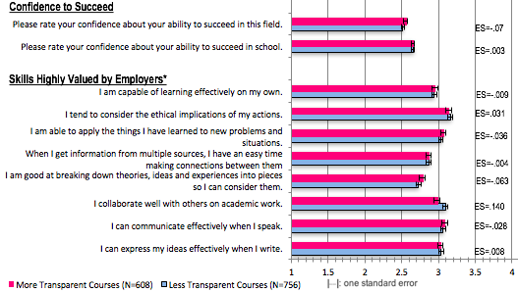
Baseline Equivalence, Beginning of Term
All Disciplines, All Students
(N=485)
(N=630)

Slide 14
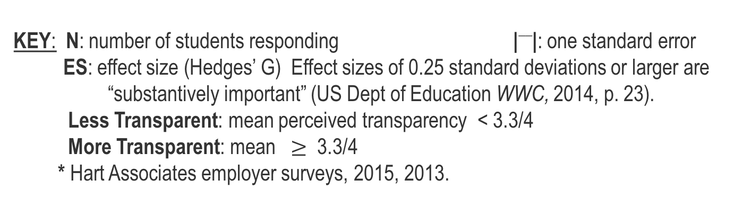
Amount of Transparency
ES=.80
Employer-valued Skills*
Academic Confidence
ES=.50
Sense of Belonging
ES=.64
KEY: N: number of students responding |__|: one standard error
ES: effect size (Hedges’ G) Effect sizes of 0.25 standard deviations or larger are
“substantively important” (US Dept of Education WWC, 2014, p. 23).
Less Transparent: mean perceived transparency < 3.3/4
More Transparent: mean $≥$ 3.3/4
* Hart Associates employer surveys, 2015, 2013.
Notes:
For example, ethnically underrepresented (African-American) first-year college students who completed an exercise that aimed to increase their feelings of social belonging earned higher GPAs in the next three years, reduced the racial achievement gap, reduced their feelings of self-doubt, increased their confidence and were more likely to be in the top 25% of their college class (Walton Walton, Gregory M., and Geoffrey L. Cohen. 2011. “A Brief Social-Belonging Intervention Improves Academic and Health Outcomes of Minority Students.” Science 331 (6023): pp. 1447-1451.
). In addition, struggling college students increased their test scores after endorsing the belief that intelligence is not fixed but rather malleable. One year later, these students were 80% less likely to drop out of college, and their GPAs continued increasing (Aronson, J., C. Fried, and C. Good. 2002. “Reducing the Effects of Stereotype Threat on African American College Students by Shaping Theories of Intelligence.” Journal of Experimental Social Psychology 38: 113–125.). For both white and African American first-year college students, sense of belonging can indirectly increase students’ persistence behaviors (Hausmann, Leslie R. M., Feifei Ye, Janet Ward Schofield and Rochelle L Woods. 2009. “Sense of Belonging and Persistence in White and African American First-Year Students. Research in Higher Education 50, 7: 649-669.). Hart Research Associates. 2015. Falling Short? College Learning and Career Success. Washington, DC: AAC&U.
____ ____. 2013. It Takes More than a Major: Employer Priorities for College Learning and Student Success. Washington, DC: AAC&U.

Slide 15
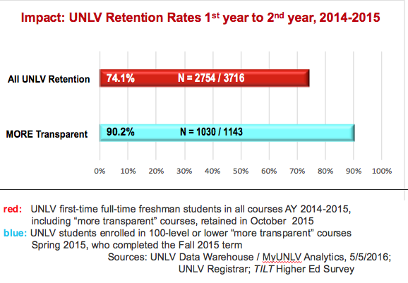

Slide 16
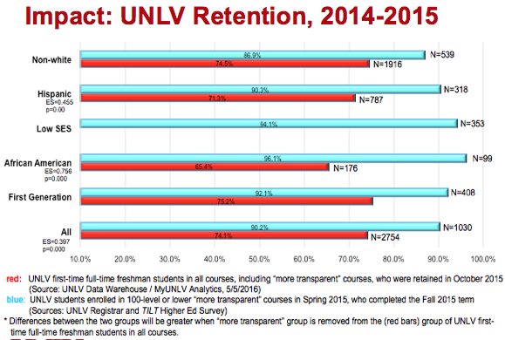

Slide 17
What does Transparent Assignment Design look like?
Faculty/Instructors agreed (in national study)
to discuss with students in advance:
Purpose
    What Skills will students practice? importance
    What Knowledge will students gain?
Task
    What students will do
    How to do it
Criteria for success
    What excellence looks like (annotated examples)
    Criteria in advance so students can self-evaluate
Winkelmes et al, AAC&U’s Peer Review (Winter, 2016)
Notes:
Mary-Ann

Slide 18
Where does Transparent Assignment Design Come From?
 | Research on Learning | Implications for Transparent Design
Elbow, Jaschik/Davidson, Mazur Ambrose, Bergstahler Gregorc, Kolb | Low stakes for greater creativity / risk Varied and/or flexible formats appeal equitably to students’ strengths; inclusive 1
Bass, Bloom, Colomb, Felder, Perry | Build critical thinking skills in intentional sequence. Target feedback to phase, don’t overwhelm 2
Doyle, Felder, Tanner, Winkelmes | Specify pertinent knowledge/skills, criteria and encourage self-monitoring. 3
Fisk/Light, Tanner | Provide annotated examples of successful work w/ criteria applied, before students begin work. 4
Aronson, Dweck, Fisk, Light, Schnabel, Spitzer, Steele, Treisman, Yeager/Walton, Vygosky | Structure and require peer instruction, feedback; positive attribution activities. 5
AAC&U Finley/McNair (HIP, P-B) Winkelmes et al Yeager, Walton | Explicate purposes, tasks, criteria in advance. Give students a compass, set expectations; Explicate applicability, relevance; Engage students in applying shared criteria to increase belonging. 6

Slide 19
Apply all that research to designing transparent, equitable assignments!

Slide 20
Sample Assignments Sample A (p. 7)
Purpose
  Skills practiced relevance to students
  Knowledge gained connection to LOs
Task: What to do
How to do it
Criteria
  What excellence looks like (annotated)
  Criteria in advance to help students to self-evaluate
}

Slide 21
Sample Assignments Sample B (p. 7)
Purpose
  Skills practiced relevance to students
  Knowledge gained connection to LOs
Task: What to do
How to do it
Criteria
  What excellence looks like (annotated)
  Criteria in advance to help students to self-evaluate
}

Slide 22
Sample Assignments Sample C (p. 8)
Purpose
  Skills practiced relevance to students
  Knowledge gained connection to LOs
Task: What to do; How to do it
Criteria
  What excellence looks like (annotated)
  Criteria in advance to help students to self-evaluate
}
It’s A, revised

Slide 23
Sample Assignments Sample D (p. 8)
Purpose
  Skills practiced relevance to students
  Knowledge gained connection to LOs
Task (problem-based, relevant)
  What to do; How to do it
Criteria
  What excellence looks like (annotated)
  Criteria in advance to help students to self-evaluate
}
Importance beyond context
Compare to B

Slide 24
Gather Feedback on Your Own Assignment
  Why are we doing this now?
  Purpose
  Knowledge: share feedback, insights
  Skills: apply transparency; engage community of practice
  Task
  Four steps, 4 - 6 min each, in pairs / 3s
  Criteria
  draft you can use in your course
  helpful insights from colleagues as novices

Slide 25
5 minute BREAK
Sit next to a disciplinary stranger when you return

Slide 26
Choose an Assignment from Your Course
  from 1st half of the term
  after students are acquainted with basic tools and terminology the course uses
  when students are starting to apply those and try them out
  Describe this assignment to a partner
  (2 min each)

Slide 27
Feedback on Your Assignments, part 1 of 3 handout: page 6
  As a novice student, offer feedback on the Purpose
    In pairs or 3s, discuss and define (6 min total)
  Five years after taking your course,
    What essential knowledge should students retain from doing this assignment?
    What skills should students be able to perform from doing this assignment? (p. 2 may help)
    Why are these important to students?

Slide 28
Feedback on Your Assignments, part 2 of 3 handout page 6
  As a novice student, offer feedback on the Task
    In pairs, discuss and define (6 min total)
  As a novice, list the steps you’d take to do the assignment.

Slide 29
Feedback on Your Assignments, part 3 of 3 handout page 6
  As a novice student, offer feedback on the Criteria
    In pairs or 3s, discuss and define (6 min total)
  As a novice:
  Are you confident you are doing the task effectively?
  Are you confident you are doing excellent work?
  Do you have annotated good examples?
  To answer yes, what would you need?

Slide 30
Additional Research-based Strategies handout page 1
Offer feedback in pairs, 3s (4 min total)
  Which additional research-based methods
  could be used? (chart, p. 1)

Slide 31
How did we do in this peer activity?
  Purpose
  Knowledge: share feedback, insights
  Skills: apply transparency; engage community of practice
  Task
  Four steps, 4 - 6 min each, in pairs / 3s
  Criteria
  draft you can use in your course
  helpful insights from colleagues as novices
  Strategies (chart, page 1)
Notes:
Mary-Ann

Slide 32
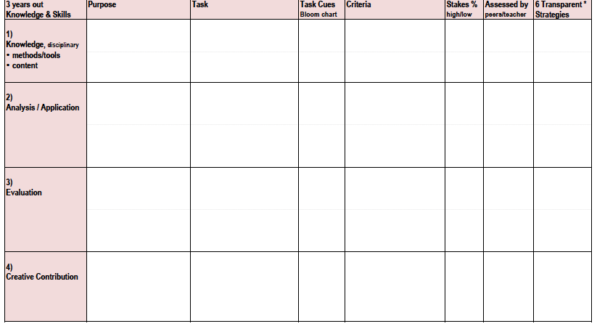
Your in-class Activities (p. 9)
[------You just did this part in pairs. ---------------------medium----------------------]
This is where an in-class activity can prepare students to excel on next assgt.
------Are students now ready to excel on this graded assignment?---------

Slide 33
Your in-class Activities (p. 9)
In-class activity for practice before students do it for a grade (low stakes)
Take-home assignment med/hi stakes
In-class activity for practice before students do it for a grade (low stakes)
Take-home assignment med/hi stakes
In-class activity for practice before students do it for a grade (low stakes)
Take-home assignment med/hi stakes

Slide 34
How did we do?
PURPOSE:
  Consider and apply research on college students’ learning to the design of transparent course assignments / activities that offer equitable opportunities for all students to succeed
TASKS:
  Review research findings
  Apply to revising your assignments and activities
CRITERIA:
You’ll leave with
  Overview of research
  Strategies to revise your assignments and activities
  Draft ideas for an assignment, an activity
  Long term: improved student confidence, skills, success

Slide 35
Strategies for Impact
Courses: Intro (large,small), Gateway, High DWF, Majors/Pathways, Gen Ed
Networks: Community Colleges, Research Intensive, Liberal Arts, Regional, Teaching/Learning Centers, STEM Ed Ctrs, Disciplinary Association conferences...

Slide 36

Please join us!
http://www.unlv.edu/provost/teachingandlearning
Transparent 2nd Tuesdays at 2:00 pm
https://zoom.us/s/337401450

Slide 38
Expanding Inclusive Teaching Practices: What's Needed?
Mary-Ann Winkelmes
Coordinator, Instructional Development & Research
University of Nevada, Las Vegas

Slide 39
Overview
Review research, with new impact data
Question/answer
Discuss: What resources would you need
  to implement transparent instruction on your own;
  to encourage inclusive teaching practices more broadly at your institution

Slide 41
Partnership with
  Grant from: TG
Co-PIs: Tia Brown McNair, Ashley Finley, AAC&U
Schools:
  Community College of Philadelphia
  Queensborough Community College, Bayside, NY
  St Edward's Univ. Austin, TX
  Univ. of Houston – Downtown, TX
  California State University, LA
  Winston-Salem State University, NC
  Heritage University, Toppenish, WA
Publication: Peer Review (Spring 2016)
Notes:
Like to ack the Partnership with the AAC&U that made this recent research possible, along with grant funding from TG Philanthropy. Tia M and Ashley F from the Association of American Colleges and Universities were my co-investigators. 7 MSIs participated.

Slide 42
Early Engagement Hypothesis
Context:
We lose the greatest numbers of underserved students from college in their first year.
Two teaching practices that show learning benefits for all students, especially underserved:
  Problem-centered for underserved engagement (Finley, McNair 2013)
  Transparency in teaching/learning (Winkelmes 2013)
Hypothesis: Combining these in introductory courses might
improve students’ learning experiences, the quality of students’ work, and students’ persistence/retention.

Slide 43
Research Question
What is the effect when teachers provide two transparently designed take-home assignments (compared to the unrevised, business-as-usual take-home assignments in the comparison group) on spring-term first-year college students’ learning experiences, especially underserved students’ experiences, as measured by:
amount of transparency students perceived in the course
students’ self-ratings of three important predictors of success: academic confidence, sense of belonging, and mastery of skills that employers value (measured by the Transparency Survey)
direct assessment of students’ work as indicated by scored student work samples, selected randomly
short-term retention rates.

Slide 44
Perceived Transparency in the Course
In this course, I knew the purpose of each assignment.
Each assignment included a section that explained how the assignment was related to the objectives of the course.
My instructor identified a specific learning goal for each assignment.
In this course, I knew the steps required to complete my assignments.
Each assignment included a detailed set of instructions for completing it.
My instructor provided detailed directions for each learning activity that was assigned.
In this course, I knew how my work would be evaluated.
My instructor provided students with annotated examples of past students’ work.
My instructor provided tools I could use to assess the quality of my and others' work.
  Never, Sometimes, Often, Always

Slide 46
Awareness of Improvement of Employer-valued skills
4. How much has this course helped you in writing effectively?
5. How much has this course helped you in communicating your ideas effectively in your spoken
statements?
6. How much has this course helped you in collaborating effectively with others?
8. How much has this course helped you in improving your ability to separate and examine the pieces of
an idea, experience, or theory?
9. How much has this course helped you in learning how to connect information from a variety of
sources?
10. How much has this course helped you in learning how to apply concepts to practical problems or in
new situations?
11. How much has this course helped you in considering the ethical implications of your actions?
Not at all, A little, A moderate amount, A lot, A great deal
22. As a result of taking this course are you a better or worse judge of the strengths and weaknesses of
ideas, or has the course made no difference?
24. As a result of taking this course are you a better or worse judge of the reliability of information from
various sources, or has the course made no difference?
Much worse, Somewhat worse, No difference, Somewhat Better, Much Better
32. Are you likely to apply knowledge and skills you gained from this course in contexts outside of this
course?
Not likely, Slightly likely, Moderately likely, Very likely, Extremely likely

Slide 47
Academic Confidence & Sense of Belonging
Confidence
30. Please rate your confidence about your ability to succeed in school.
31. Please rate your confidence about your ability to succeed in this field.
Low, Moderate, High
25. As a result of taking this course are you more or less confident about your
ability to succeed in school, or has the course made no difference?
26. As a result of taking this course are you more or less confident about your
ability to succeed in this field, or has the course made no difference?
Much less confident, Somewhat less confident, No difference,
Somewhat more confident, Much more confident
Belonging
34. How much did class meetings incorporate the students' suggestions and
interests?
35. How much did the instructor value you as a student?
Not at all, A little, A moderate amount, A lot, A great deal

Slide 48
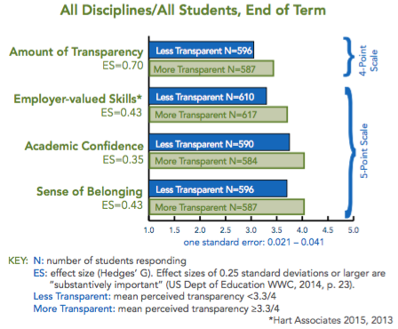
Impact: Boosted Predictors, national study

Slide 49
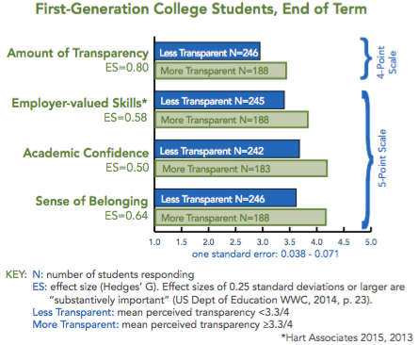
Impact: Boosted Predictors, national study
Winkelmes, Bernacki, Butler, Golanics, Zochowski, Harriss Weavil, Peer Review 2016

Slide 50
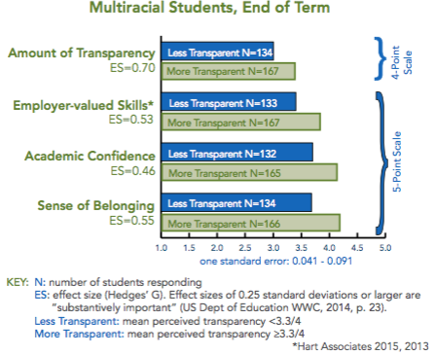
Impact: Boosted Predictors, national study

Slide 51
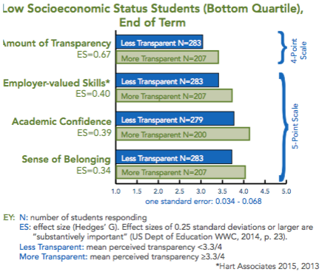
Impact: Boosted Predictors, national study

Slide 52
Impact: Boosted Predictors, UNLV

Slide 53
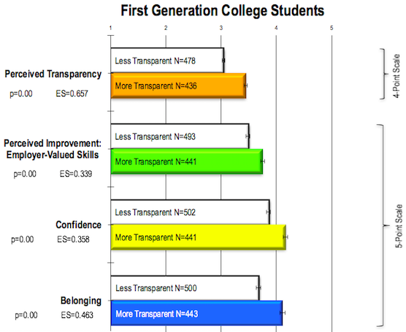

Impact: Boosted Predictors, UNLV

Slide 54
Impact: UNLV Retention Rates 1st year to 2nd year, 2014-2015
N = 2754 / 3716
red: UNLV first-time full-time freshman students in all courses AY 2014-2015,
including “more transparent” courses, retained in October 2015
blue: UNLV students enrolled in 100-level or lower “more transparent” courses
Spring 2015, who completed the Fall 2015 term
Sources: UNLV Data Warehouse / MyUNLV Analytics, 5/5/2016;
UNLV Registrar; TILT Higher Ed Survey

Slide 55
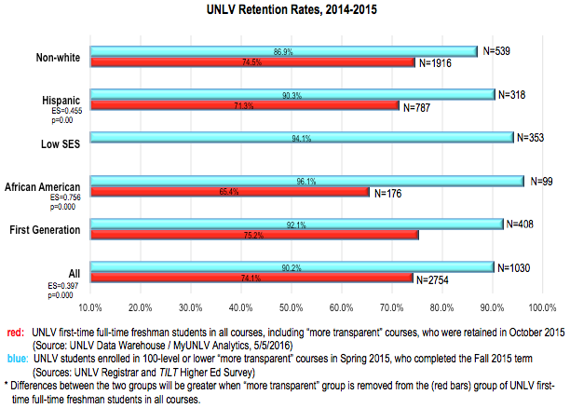
Impact : UNLV Retention, 2014-2015

Slide 56
UNLV General Education Assessment Summit, 2014
FYS Instructors surveyed:
placed “Major Emphasis” on communication skills:
  Effective writing within a discipline
  Collaborate effectively with others

Slide 57
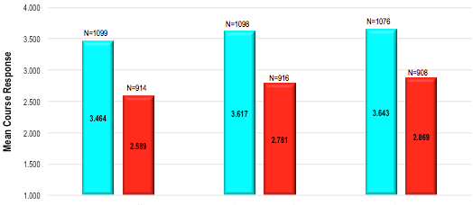
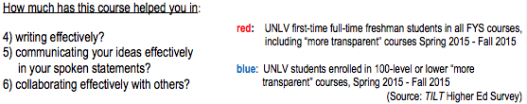
Impact on UNLV students’ views of learning
How much did this course help you in:
written communication spoken comm collaborating effectively
red: UNLV first-time full-time freshman students in all courses, including “more transparent”
blue: UNLV students enrolled in 100-level or lower “more transparent” courses

Slide 58
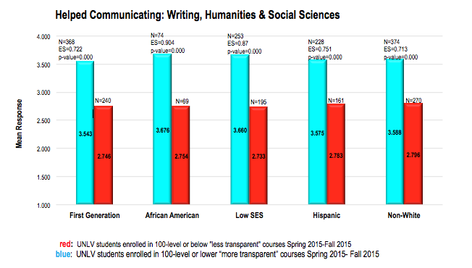
Impact on UNLV students’ views of learning

Slide 59
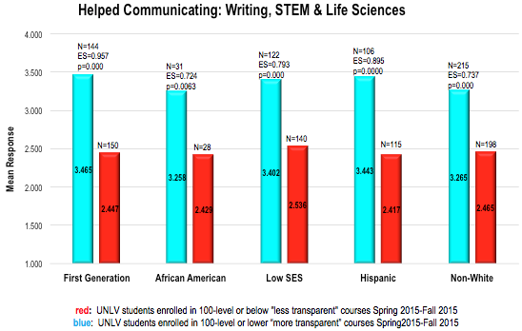
Impact on UNLV students’ views of learning

Slide 60
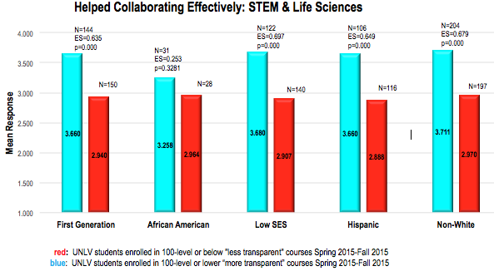
Impact on UNLV students’ views of learning

Slide 61
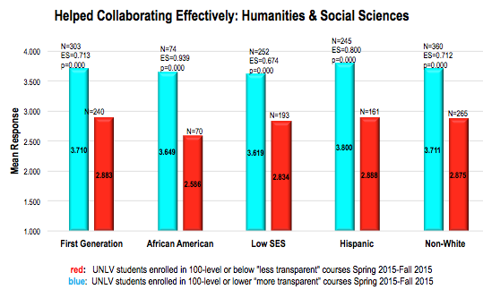
Impact on UNLV students’ views of learning

Slide 62
Strategies for Impact
Courses: Intro (large,small), Gateway, High DWF, Majors/Pathways, Gen Ed
Networks: Community Colleges, Research Intensive, Liberal Arts, Regional, Teaching/Learning Centers, STEM Ed Ctrs, Disciplinary Association conferences...

Slide 63
Questions and Comments

Slide 64
DISCUSS in groups; Report back
Individual Instructors
What resources do you need to implement transparently designed assignments at your own discretion in your own courses?
Where can you find those resources?

Slide 65
DISCUSS in groups; Report back
Institutions
What specific goals at your institution might benefit from an inclusive teaching initiative?
  retention rates
  graduation rates
  increased diversity of students, and/or faculty and staff
  increased student satisfaction, faculty/staff satisfaction
  community engagement
  research productivity
  scholarship of teaching and learning

Slide 66
DISCUSS in groups; Report back
Institutions
What kinds of courses would help us achieve the greatest impact on underserved students?
intro (large, small); freshman seminars; remedial/bridge;
High DFW; Gen Ed; Pathways through major; Gateway
What kinds of campus units might make strong partners in an inclusive teaching initiative?
academic advising; tutoring; campus recreation
Library; registrar; community engagement / diversity
online education; continuing education

Slide 67
Please join us!
http://www.unlv.edu/provost/teachingandlearning
http://tinyurl.com/jsqykkh
Transparent 2nd Tuesdays at 2:00 pm
https://zoom.us/s/337401450

Slide 68
Available Resources:
TILT Survey and team reports on impact (confidence, belonging, employer skills)
DRAFT Checklist for designing a Transparent Assignment
DRAFT pilot test: Feedback from students to revise instructions for increased transparency

